Slide 1
AngularJS : Superheroic JavaScript MVW Framework
View AngularJS course details at www.edureka.co/angular-js
For Queries :
Post on Twitter @edurekaIN: #askEdureka
Post on Facebook /edurekaIN
For more details please contact us:
US : 1800 275 9730 (toll free)
INDIA : +91 88808 62004
Email us : webinars@edureka.co

Slide 2





What will you learn today?
Why should we use AngularJS
What is AngularJS
MVC & MVW Architecture
AngularJS Features
How to Build a Responsive Single Page Application

Slide 3
Why AngularJS ?

Slide 4
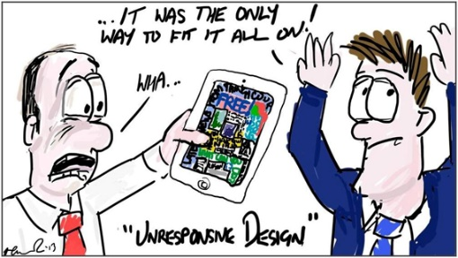
Challenges of Web Development
Responsiveness with different devices

Slide 5

Challenges of Web Development
Responsiveness with different devices
Diverse User Preferences

Slide 6

Challenges of Web Development
Responsiveness with different devices
Diverse User Preferences
Agility to server new requests with enterprise standards

Slide 7

Challenges of Web Development
Responsiveness with different devices
Diverse User Preferences
Agility to server new requests with enterprise standards
Multiple Skill Sets

Slide 8

Challenges of Web Development
Responsiveness with different devices
Diverse User Preferences
AngularJS will solve these problems
Agility to server new requests with enterprise standards
Multiple Skill Sets

Slide 9
What is AngularJS ?

Slide 10
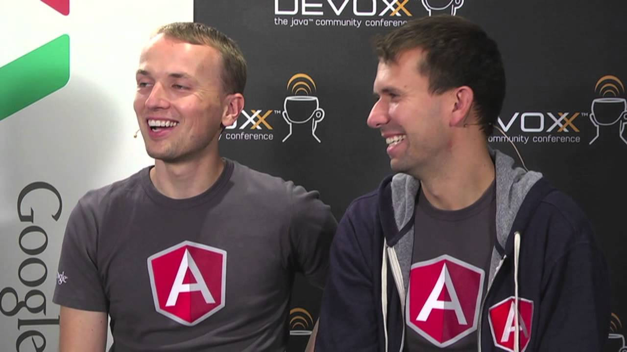
What is AngularJS?
AngularJS was originally developed in 2009 by Misko Hevery and Adam Abrons at Brat Tech LLC, firstly named as GetAngular
OpenSource client side JavaScript framework created by Google
Designed for web developers and designers, who need to have more control over their web Applications
AngularJS accomplishes a lot by embracing HTML, JavaScript and CSS

Slide 11

What is AngularJS according to Misko Hevery ?
A better way to think about angular is not to think about it as framework but as HTML compiler which allows you to create your OWN DSL in HTML, by attaching your own behavior to any HTML element, attribute or text. And by any I mean that you can make up your own names
Misko Hevery

Slide 12


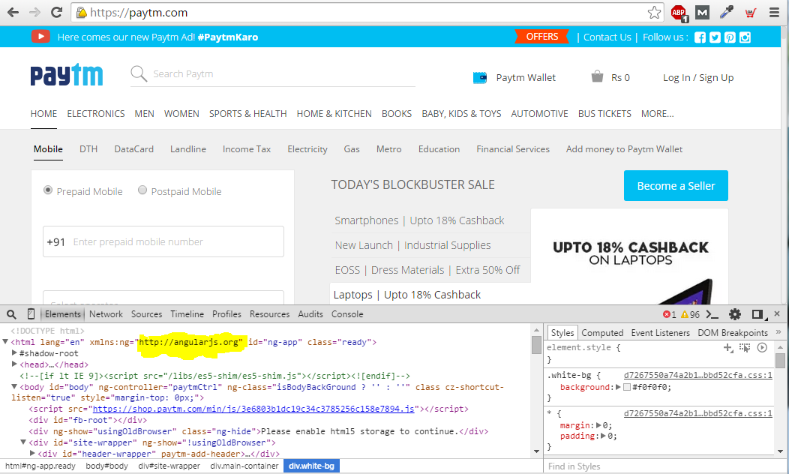

Big Brands Using AngularJS
YouTube application for Sony's PlayStation 3

Slide 13

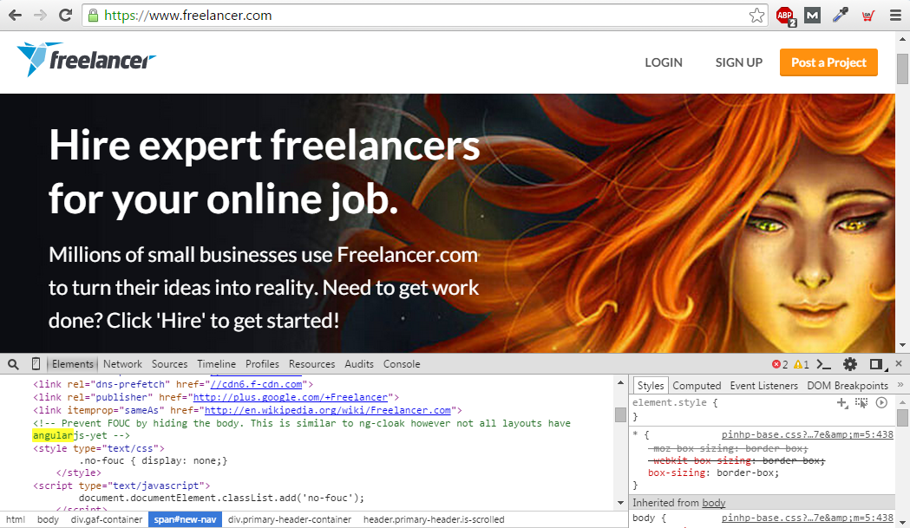

Big Brands Using AngularJS

Slide 14
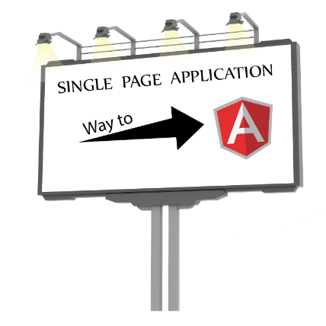

Let us see what is Single Page Application first
SPA
AngularJS
TakeAway

Slide 15
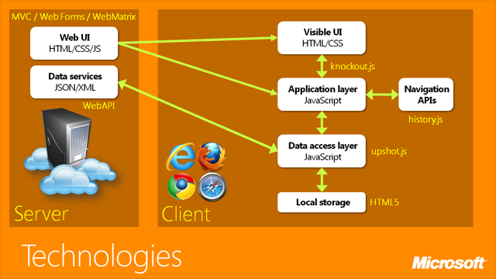
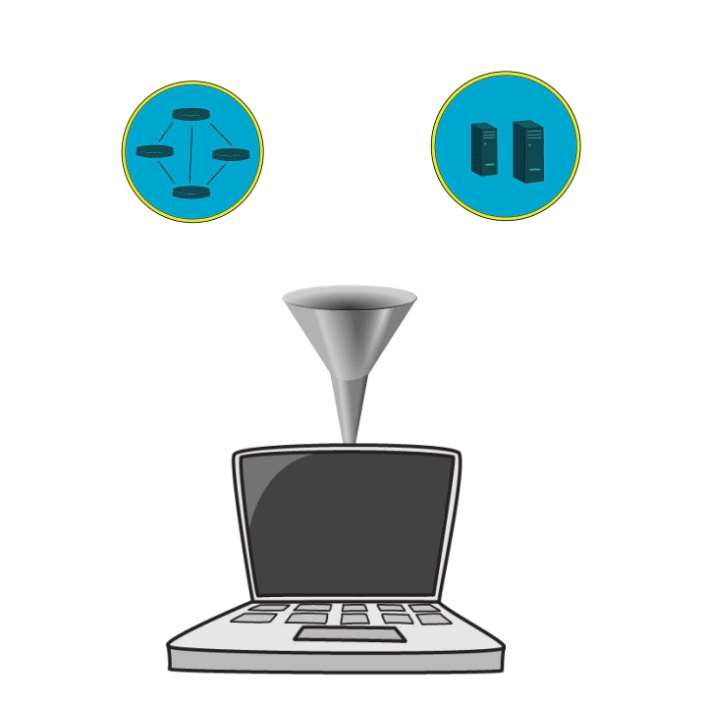
SINGLE PAGE APPLICATION
Single Page Application is a web app in which the majority of interactions are handled on the client without the need to reach a server, with a goal of providing a more fluid user experience
Client Side Routing
Client Side Rendering
Reference: https://channel9.msdn.com/

Slide 16

RESPONSIVE SINGLE PAGE APPLICATION

Slide 17




AngularJS in Detail
SPA
AngularJS
TakeAway

Slide 18
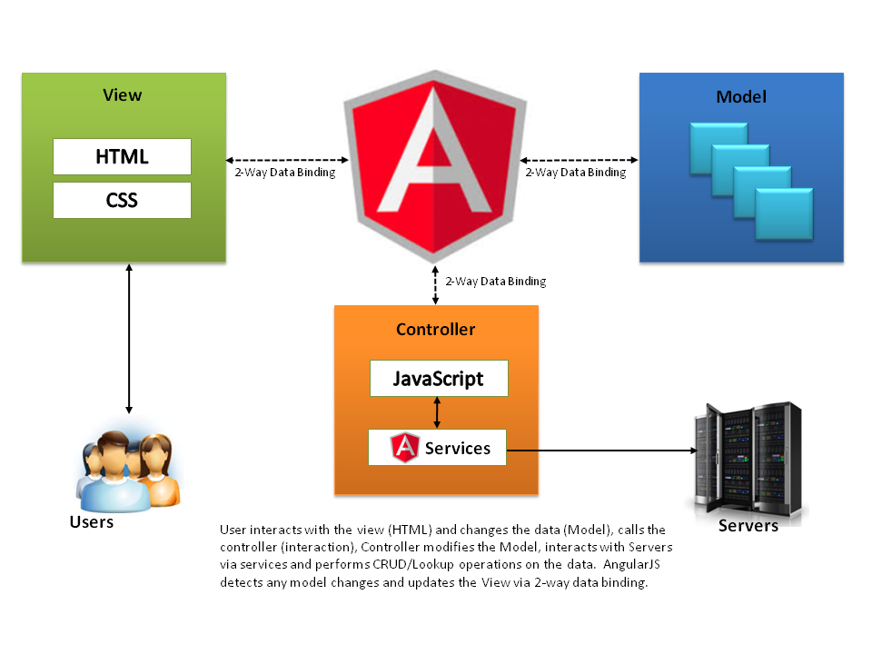

MVC & MVW Way of AngularJS
MVC
MVW
Model
View
HTML
CSS
Whatever
Controller
Directive
Unit Test
Reference: Avaldes.com

Slide 19
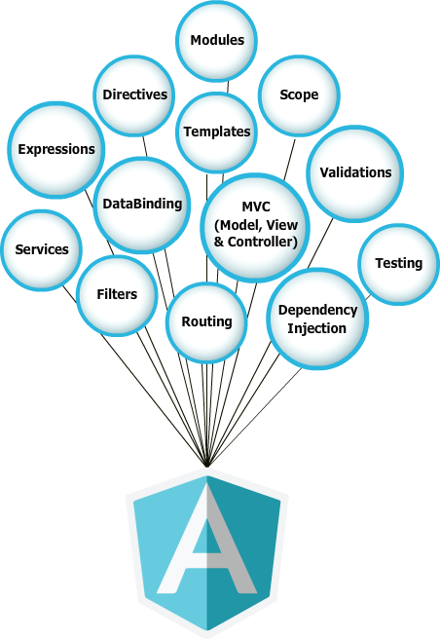
Features of AngularJS

Slide 20
How To Build Responsive SPA Using AngularJS ?

Slide 21
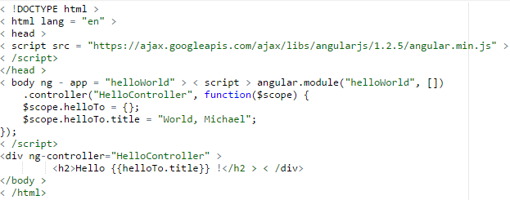
AngularJS: Your first program
Steps to create an AngularJS Application
Include AngularJS
Bootstrap the App
Create the Controller
Create the View
Run the Application

Slide 22
Demo

Slide 23
Building Highly Responsive Single Page Application
Usecase : Build a User Management Application
Prerequisite :
Text Editor (sublime or notepadd ++)
Latest browser (Firefox or Chrome)
Installed NodeJS (server)
Mongo (To store userinfo)
Project Specifications :
Login to the Application
Create a new user
View Users List
Update a existing user
Delete user
Signout

Slide 24
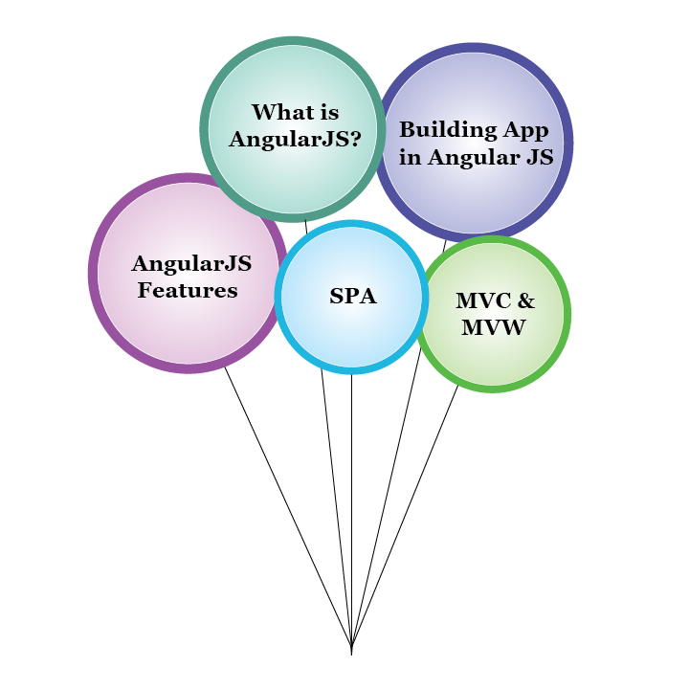





TakeAways
SPA
AngularJS
TakeAway

Slide 25

Certifications
Get certified in AngularJS by Edureka
Go to www.edureka.co/angular-js
Batch starts from 10th October (Weekend)
Edureka's AngularJS course:
It covers the fundamental concepts like directives, routes, filters, services and factors which helps to build rich user interface web applications in AngularJS.
It helps you boost your web development skills and become a sought after SPA (single page application) developer. You will learn the highly efficient Angular features like data binding, scope management, form validation, routing, i18n & lot more.
Get to implement an AngularJS mean stack-based project towards the end of the course, which gives you complete insights on the framework along with NodeJS.
Online Live Courses: 21 hours
Assignments: 20 hours
Project: 20 hours
Lifetime Access + 24 X 7 Support

Slide 26
Thank You
Questions/Queries/Feedback
Recording and presentation will be made available to you within 24 hours

